Slide 1
Machine Learning Techniques
Decision Tree & Random Forest
Instructor: Najam Aziz

Slide 2
Decision Tree

Slide 3
Decision Tree
Supervised Learning Algorithm
Used for Classification and Regression problem
The goal of using a Decision Tree is to create a training model that can use to predict the class or value of the target variable by learning simple decision rules inferred from prior data(training data).
Decision tree uses the tree representation to solve the problem in which each leaf node corresponds to a class label and attributes are represented on the internal node of the tree.
Decision Trees classify based on the feature values. They use the method of Information Gain and find out which feature of the dataset gives the best of information, make that as the root node and so on till they are able to classify each instance of the dataset.

Slide 4
Decision Tree - Assumption
In the beginning, the whole training set is considered as the root.
Feature values are preferred to be categorical. If the values are continuous then they are discretized prior to building the model.
Records are distributed recursively on the basis of attribute values.
Order to placing attributes as root or internal node of the tree is done by using some statistical approach.

Slide 5
Important Terminology related to Decision Trees
Root Node: It represents the entire population or sample and this further gets divided into two or more homogeneous sets.
Splitting: It is a process of dividing a node into two or more sub-nodes.
Decision Node: When a sub-node splits into further sub-nodes, then it is called the decision node.
Leaf / Terminal Node: Nodes do not split is called Leaf or Terminal node.
Pruning: When we remove sub-nodes of a decision node, this process is called pruning. You can say the opposite process of splitting.
Branch / Sub-Tree: A subsection of the entire tree is called branch or sub-tree.
Parent and Child Node: A node, which is divided into sub-nodes is called a parent node of sub-nodes whereas sub-nodes are the child of a parent node.

Slide 6
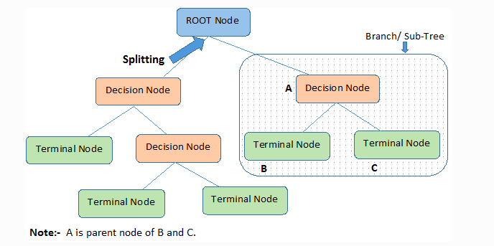

Slide 7
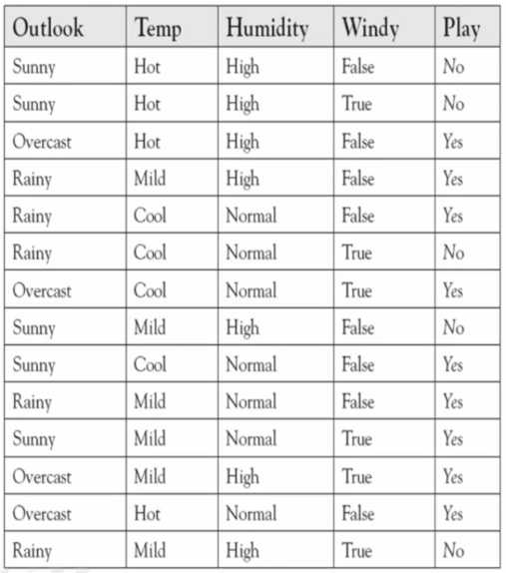
Decision Tree Example-1 (Classification And Regression Tree)

Slide 8
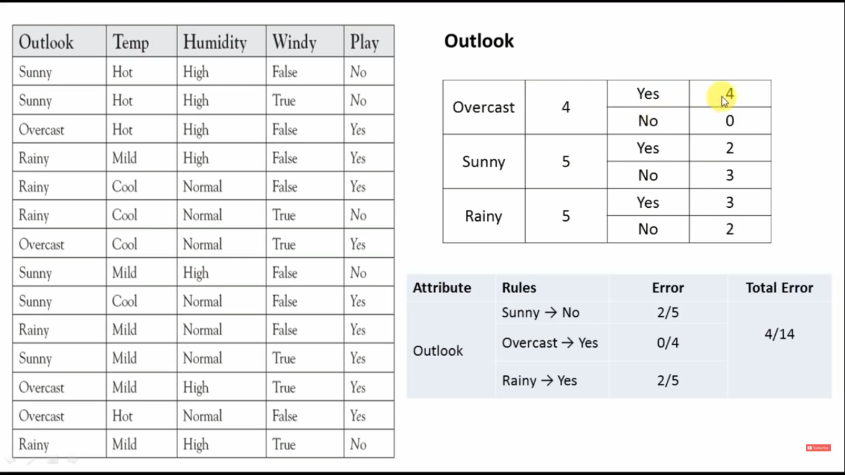

Slide 9
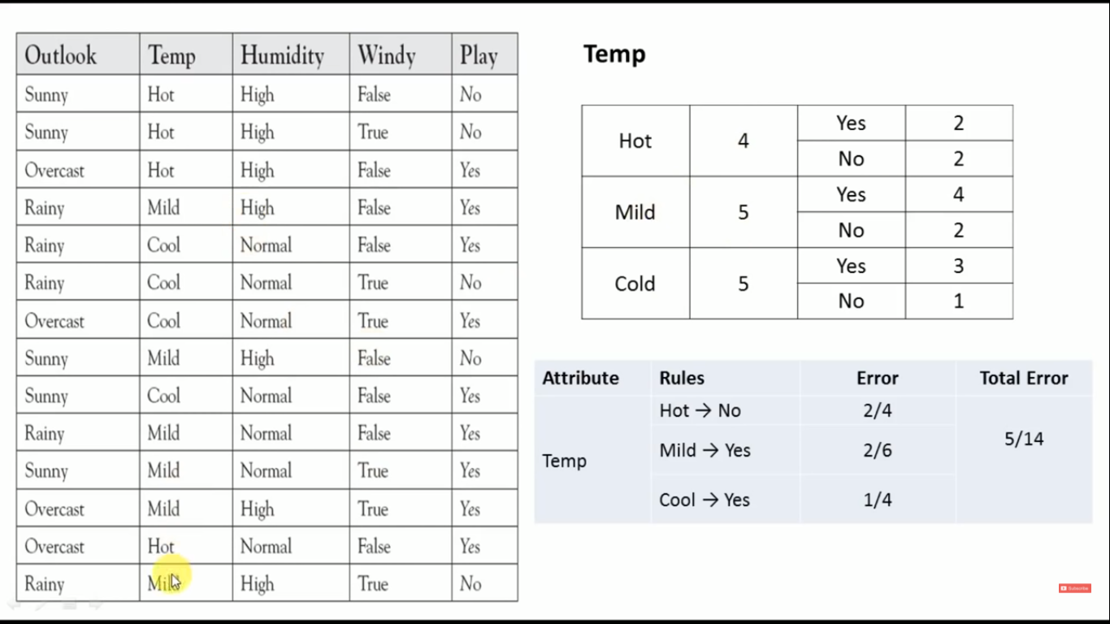

Slide 10
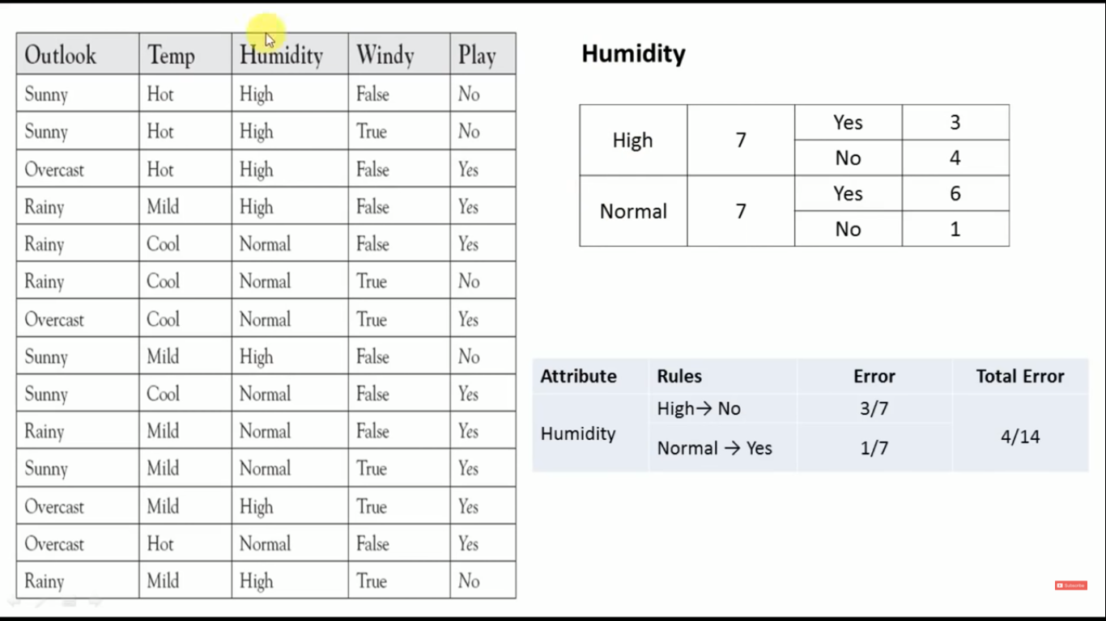

Slide 11
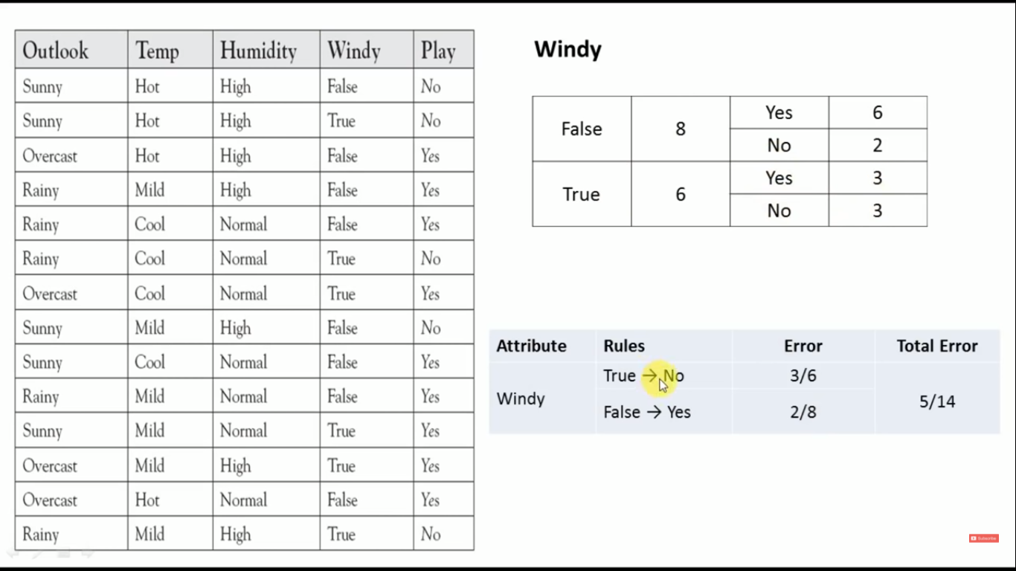

Slide 12
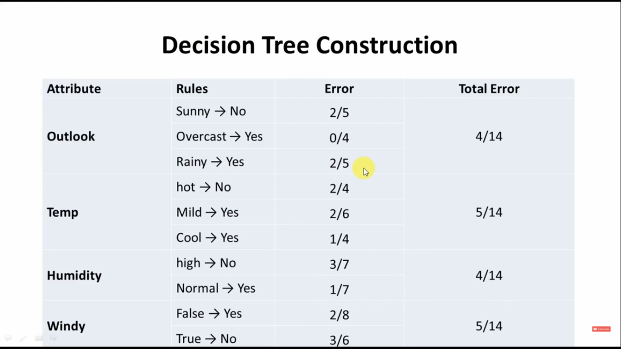
Errors of all the Features

Slide 13
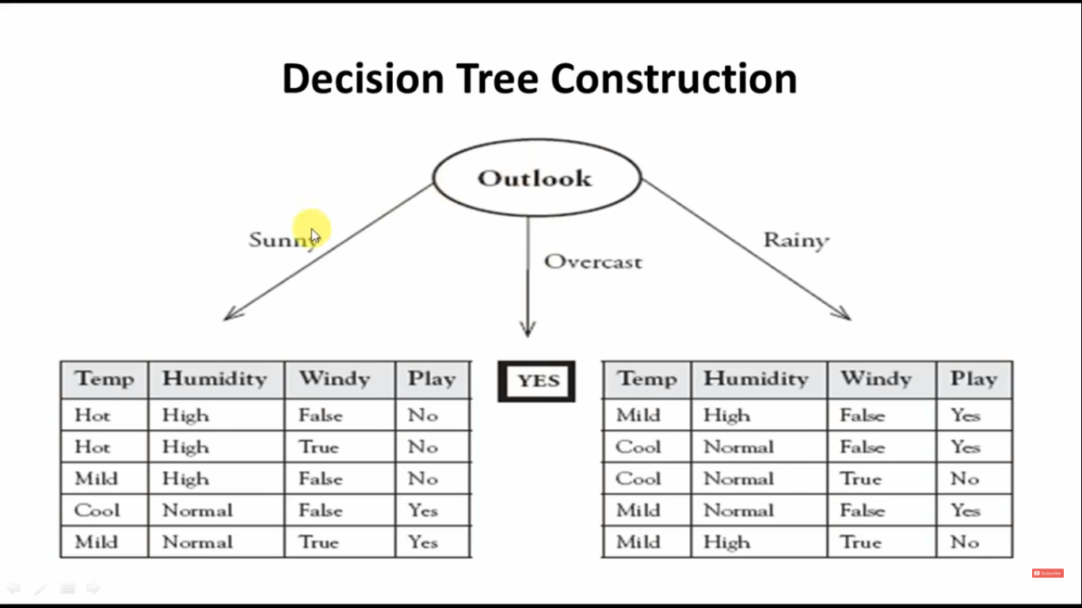
So we decided Outlook as our Root Node

Slide 14
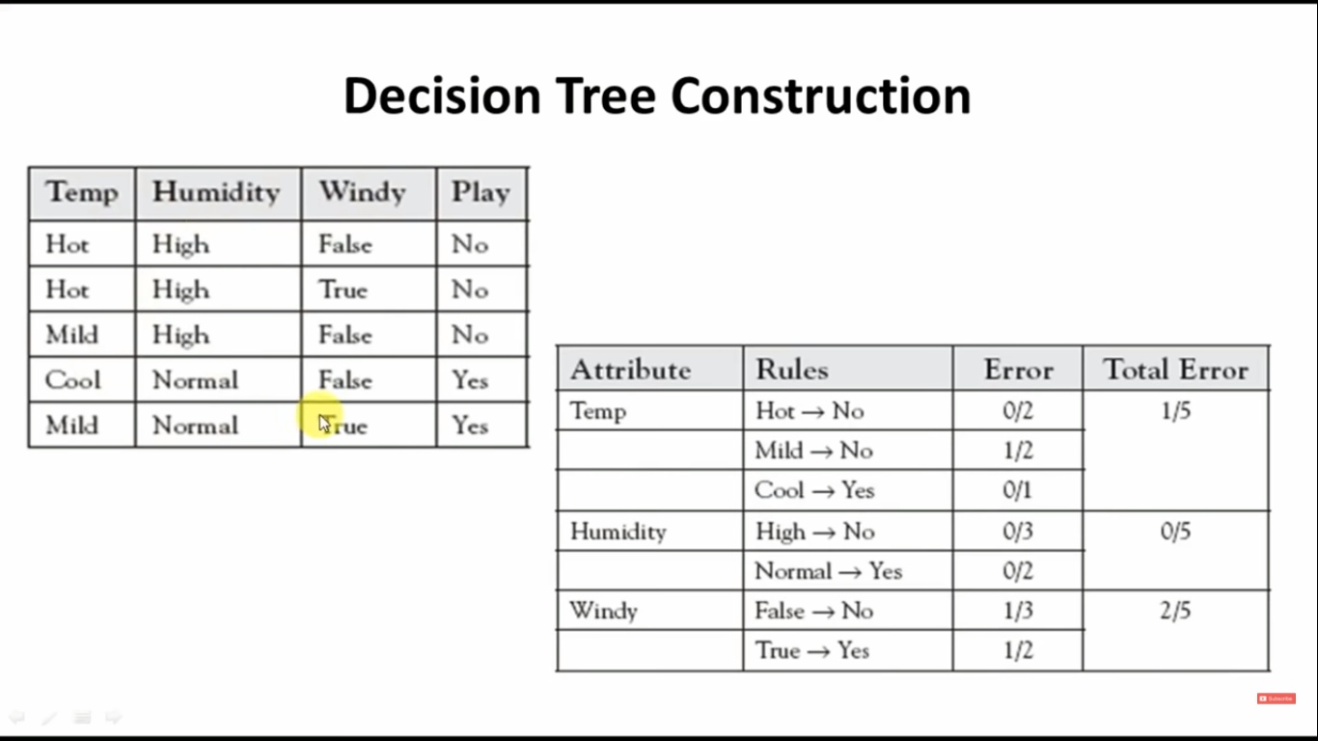
Selection of Child Node, when outlook is SUNNY

Slide 15
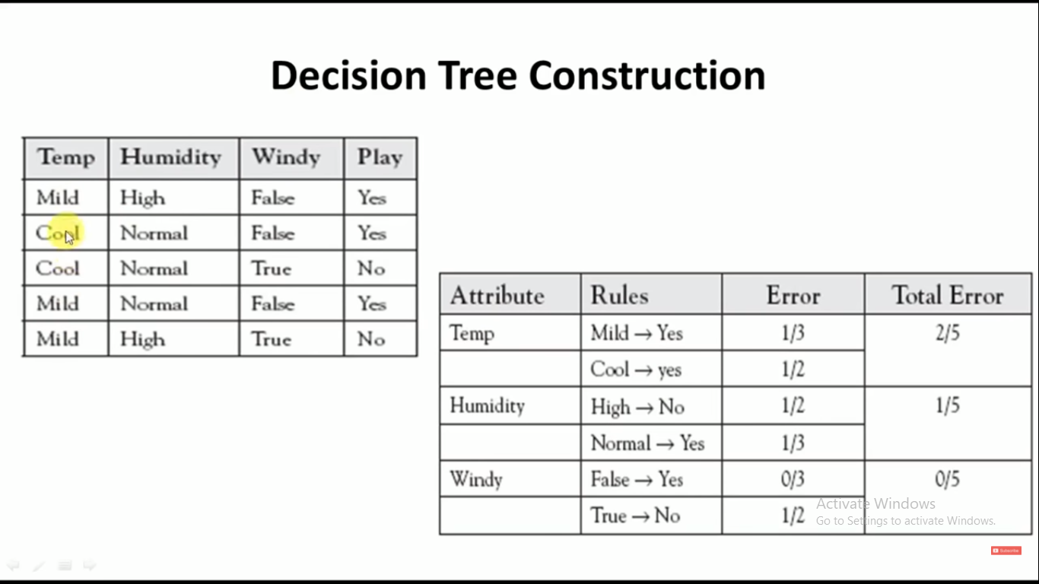
Selection of Child Node, when outlook is RAINY

Slide 16
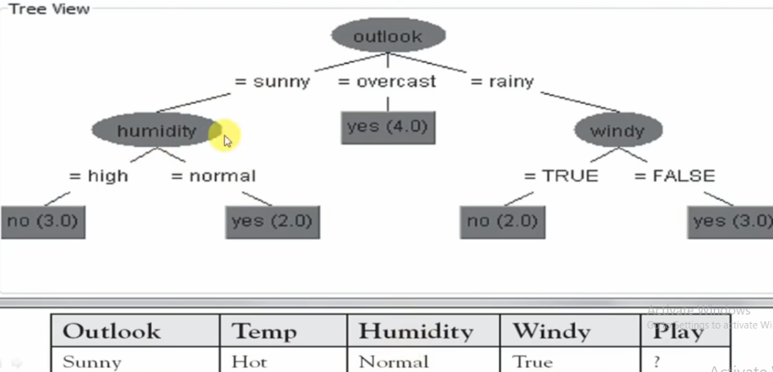
Final Tree

Slide 17
How do Decision Trees work?
The decision of making strategic splits heavily affects a tree’s accuracy. The decision criteria are different for classification and regression trees.
Decision trees use multiple algorithms to decide to split a node into two or more sub-nodes. The creation of sub-nodes increases the homogeneity of resultant sub-nodes. In other words, we can say that the purity of the node increases with respect to the target variable. The decision tree splits the nodes on all available variables and then selects the split which results in most homogeneous sub-nodes.
The algorithm selection is also based on the type of target variables.

Slide 18
Attribute Selection Measures
If the dataset consists of N attributes then deciding which attribute to place at the root or at different levels of the tree as internal nodes is a complicated step. By just randomly selecting any node to be the root can’t solve the issue. If we follow a random approach, it may give us bad results with low accuracy.
For solving this attribute selection problem, researchers worked and devised some solutions. They suggested using some criteria like : Entropy, Information gain, Gini index, Gain Ratio, Reduction in Variance Chi-Square

Slide 19
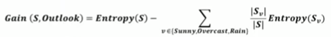
Information Gain vs Gini Index
In Decision Tree the major challenge is to identification of the attribute for the root node in each level. This process is known as attribute selection. We have two popular attribute selection measures:
Information Gain
Gini Index
These criteria will calculate values for every attribute. The values are sorted, and attributes are placed in the tree by following the order i.e, the attribute with a high value(in case of information gain) is placed at the root.
While using Information Gain as a criterion, we assume attributes to be categorical, and for the Gini index, attributes are assumed to be continuous.

Slide 20
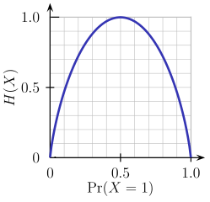
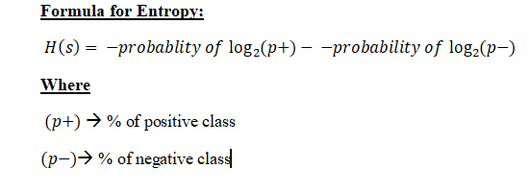
Entropy
- Entropy is the measures of impurity, disorder, or uncertainty in a bunch of examples.
- Entropy is a measure of the randomness in the information being processed. The higher the entropy, the harder it is to draw any conclusions from that information.
- Purpose of Entropy:
Entropy controls how a Decision Tree decides to split the data. It affects how a Decision Tree draws its boundaries. “Entropy values range from 0 to 1”, Less the value of entropy more it is trusting able.

Slide 21
ID3 Algorithm
ID3 stands for Iterative Dichotomiser-3 and is named such because the algorithm iteratively (repeatedly) dichotomizes(divides) features into two or more groups at each step.
is a classification algorithm that follows a greedy approach of building a decision tree by selecting a best attribute that yields maximum Information Gain (IG) or minimum Entropy (H).

Slide 22
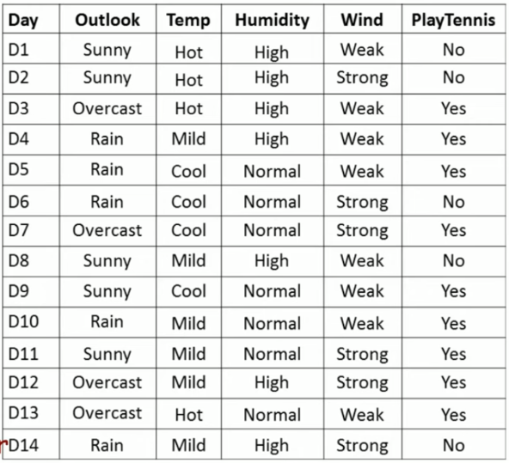
Example-1 using ID3 Algorithm

Slide 23
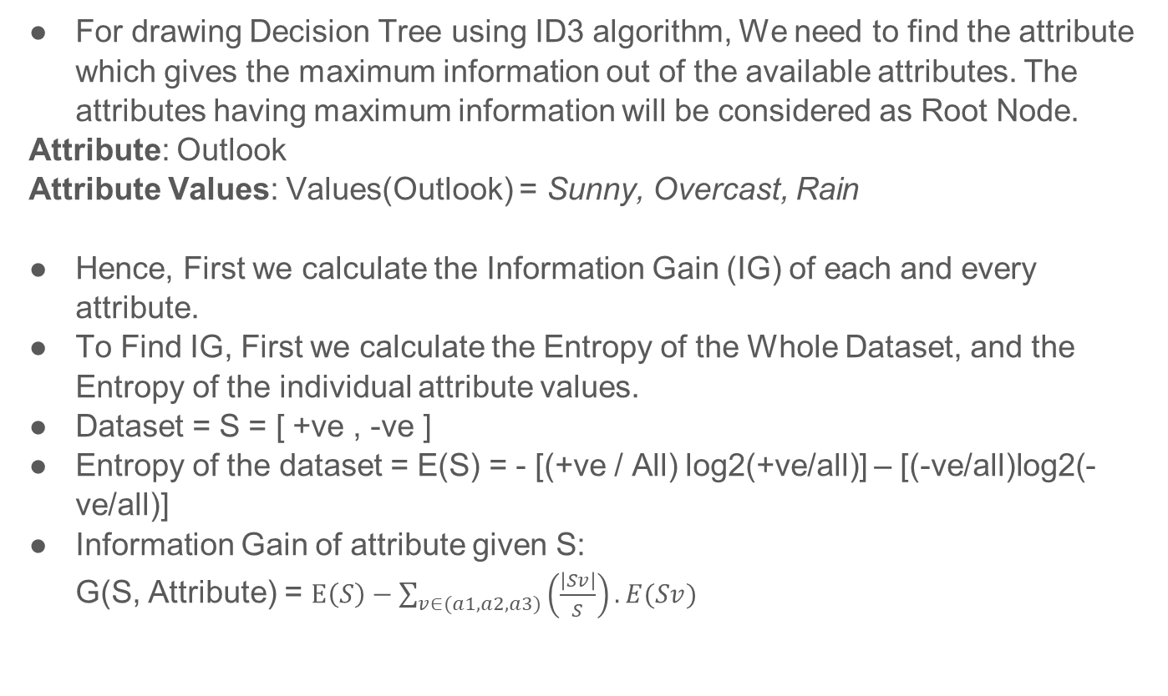
For drawing Decision Tree using ID3 algorithm, We need to find the attribute which gives the maximum information out of the available attributes. The attributes having maximum information will be considered as Root Node.
Attribute: Outlook
Attribute Values: Values(Outlook) = Sunny, Overcast, Rain
Hence, First we calculate the Information Gain (IG) of each and every attribute.
To Find IG, First we calculate the Entropy of the Whole Dataset, and the Entropy of the individual attribute values.
Dataset = S = [ +ve , -ve ]
Entropy of the dataset = E(S) = - [(+ve / All) log2(+ve/all)] – [(-ve/all)log2(-ve/all)]
Information Gain of attribute given S: G(S, Attribute) = $E\left(S\right)−\sum_{v∈(a1,a2,a3)}{\left(\frac{\left|Sv\right|}{S}\right).E(Sv)}$

Slide 24
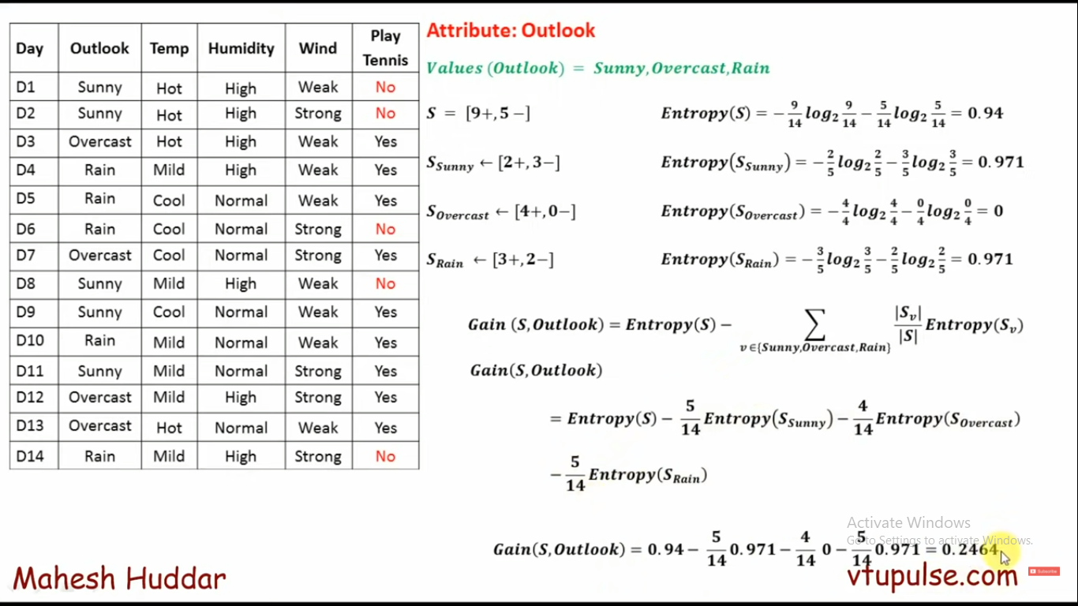

Slide 25
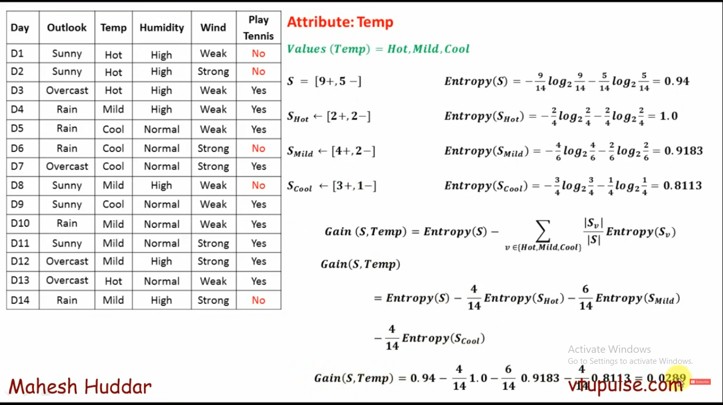

Slide 26
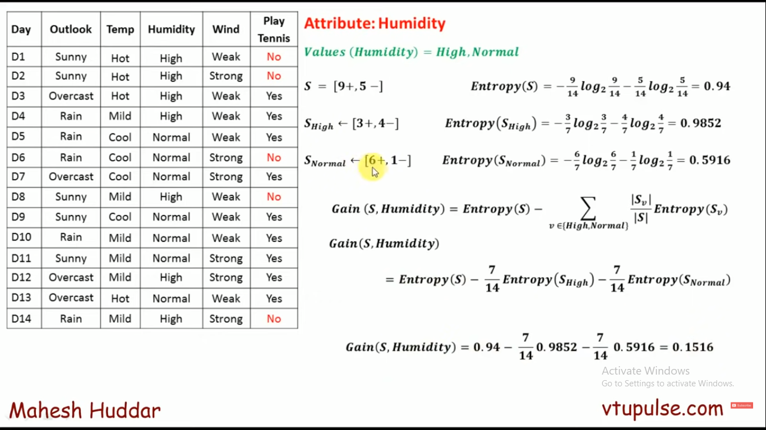

Slide 27
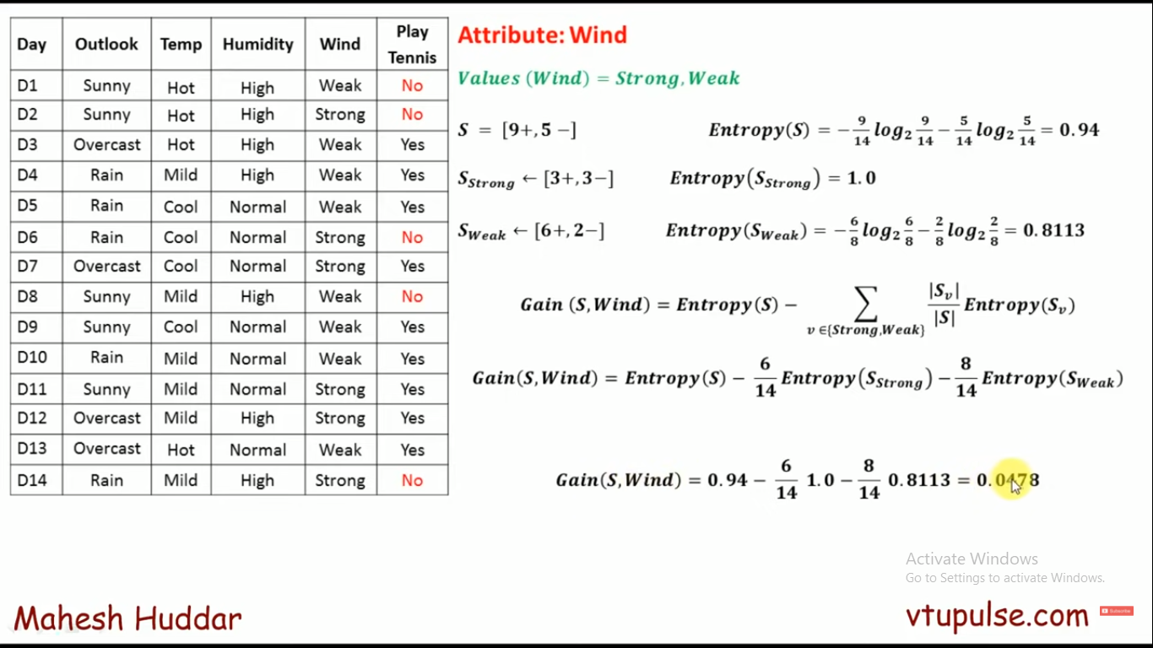

Slide 28
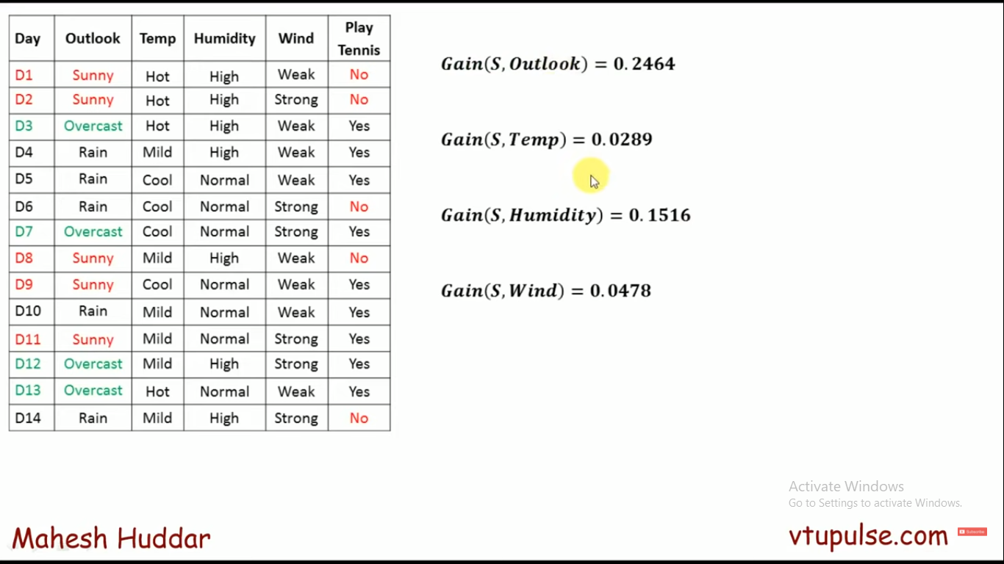

Slide 29
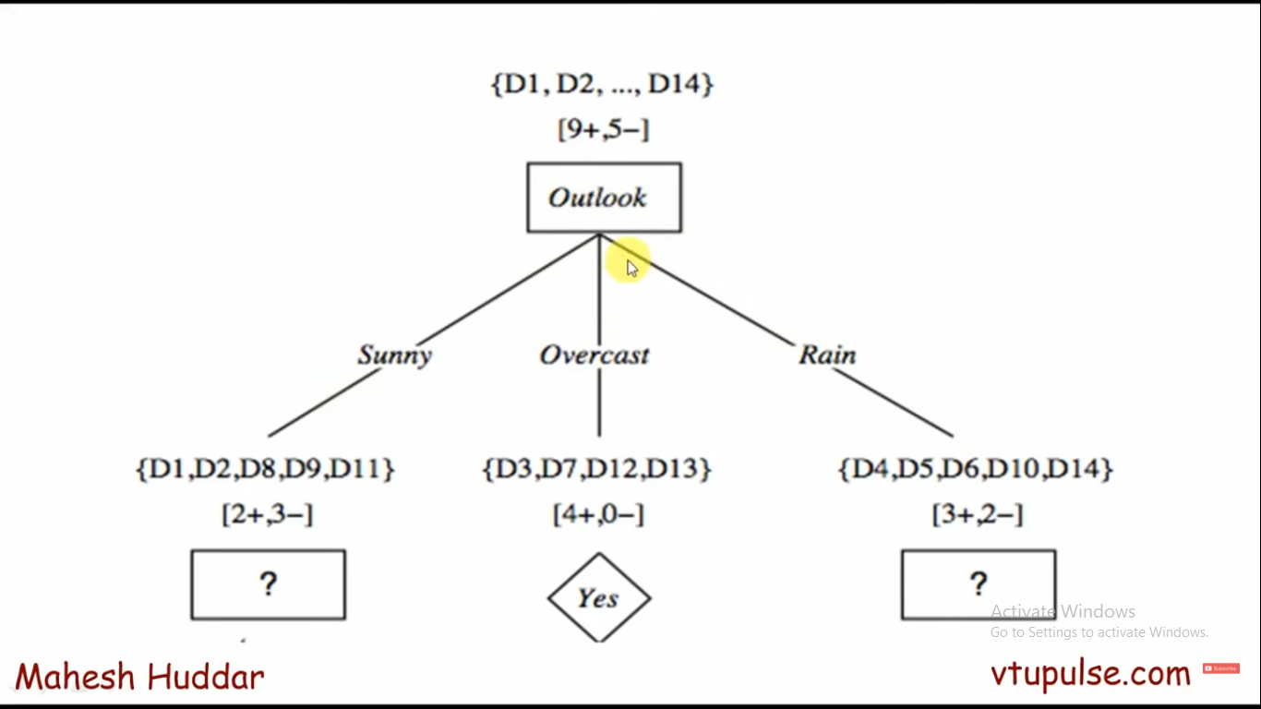

Slide 30
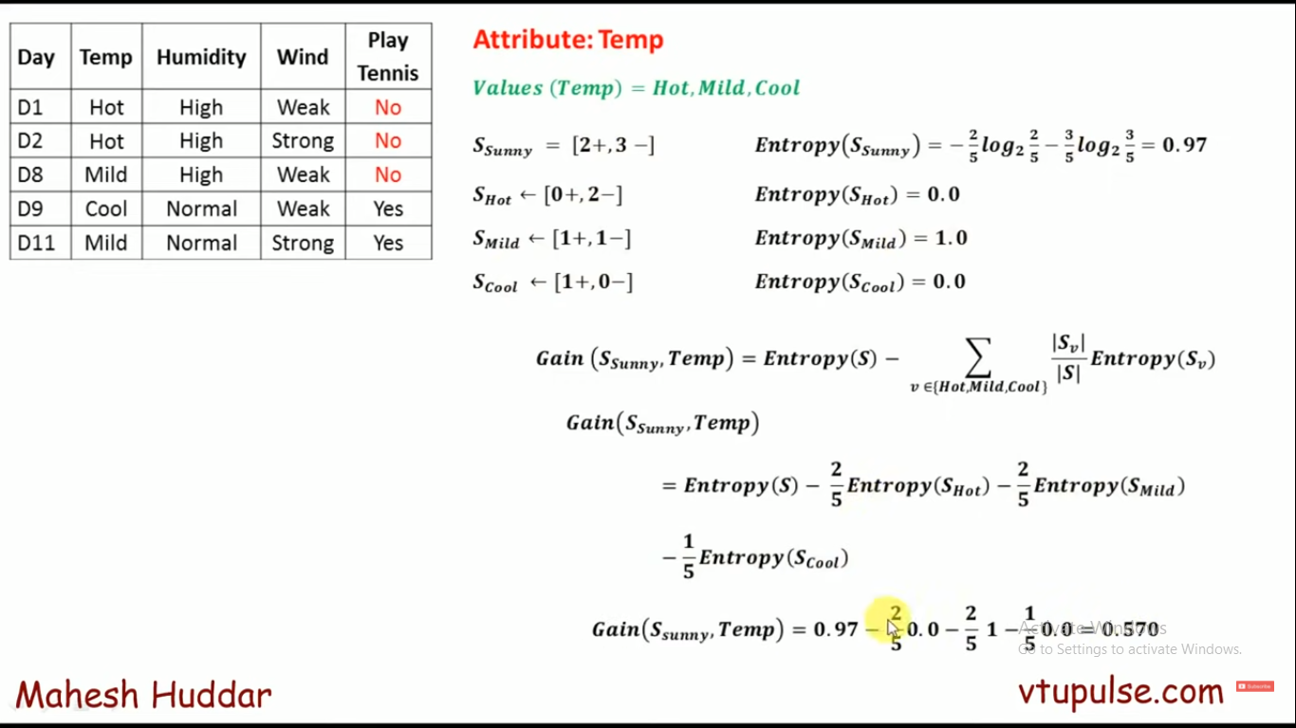
Selection of Child Node, when outlook is SUNNY

Slide 31
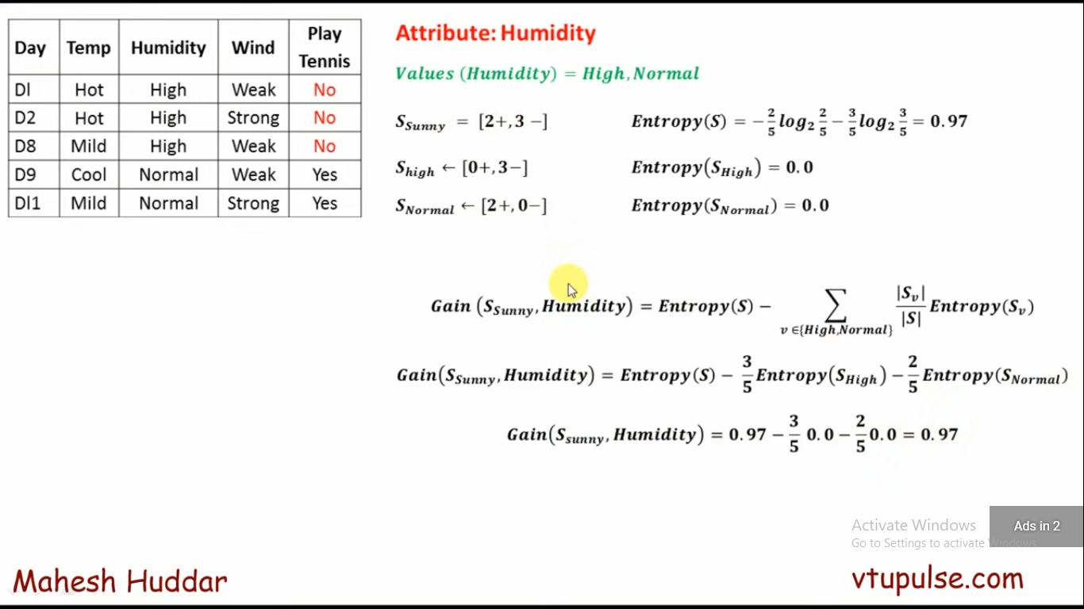

Slide 32
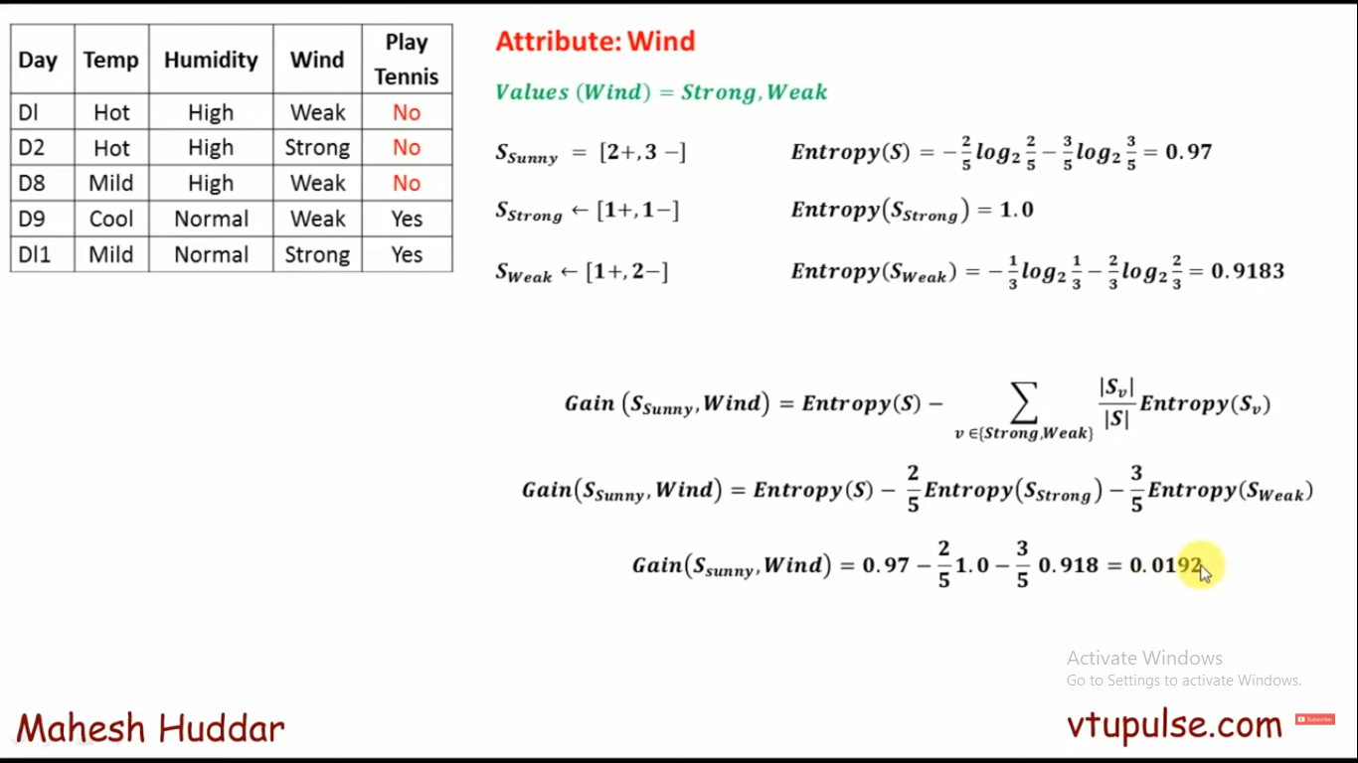

Slide 33
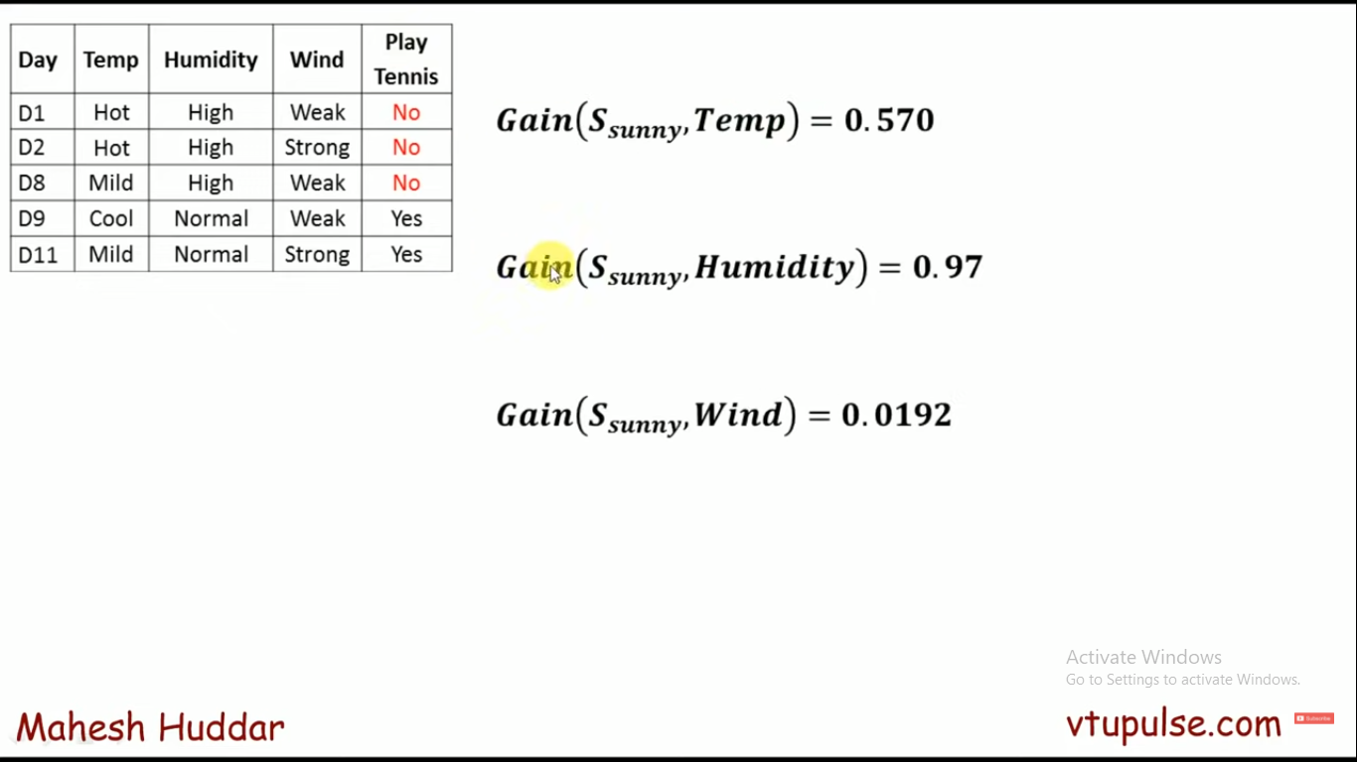

Slide 34
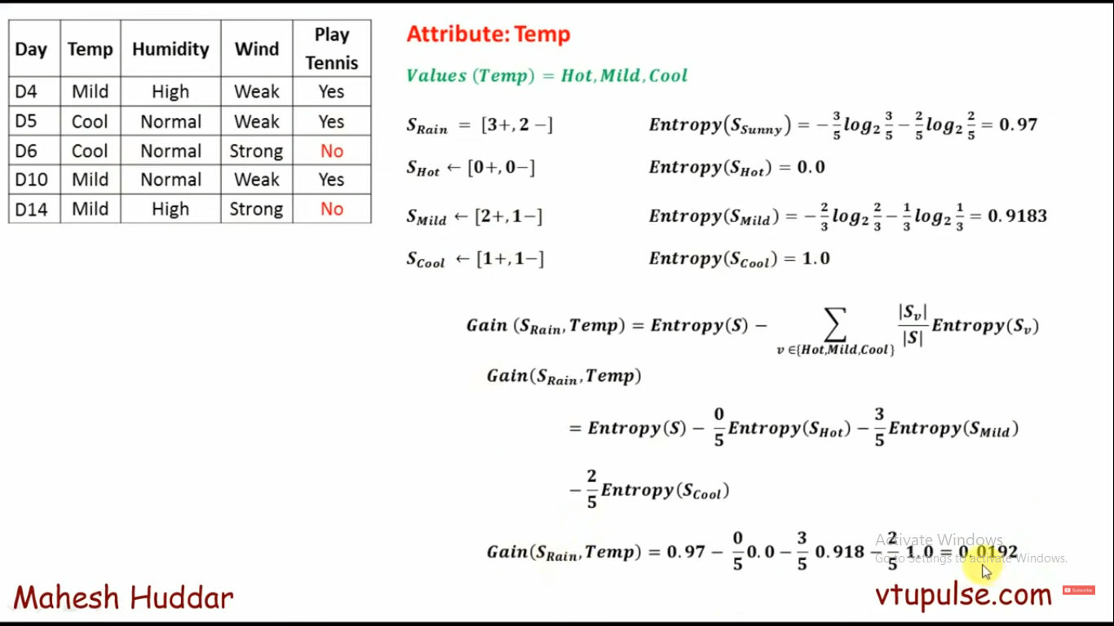
Selection of Child Node, when outlook is RAINY

Slide 35
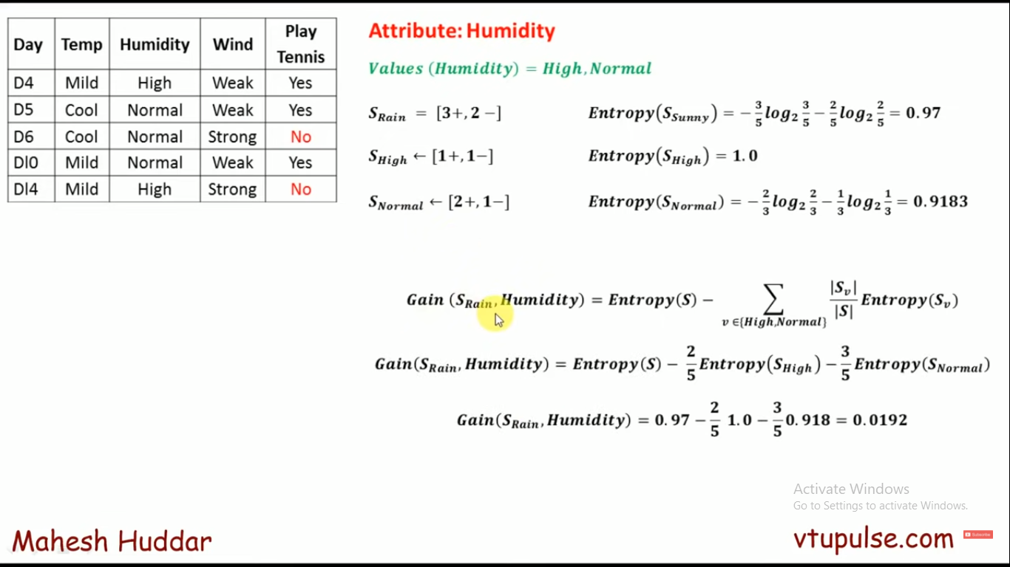

Slide 36
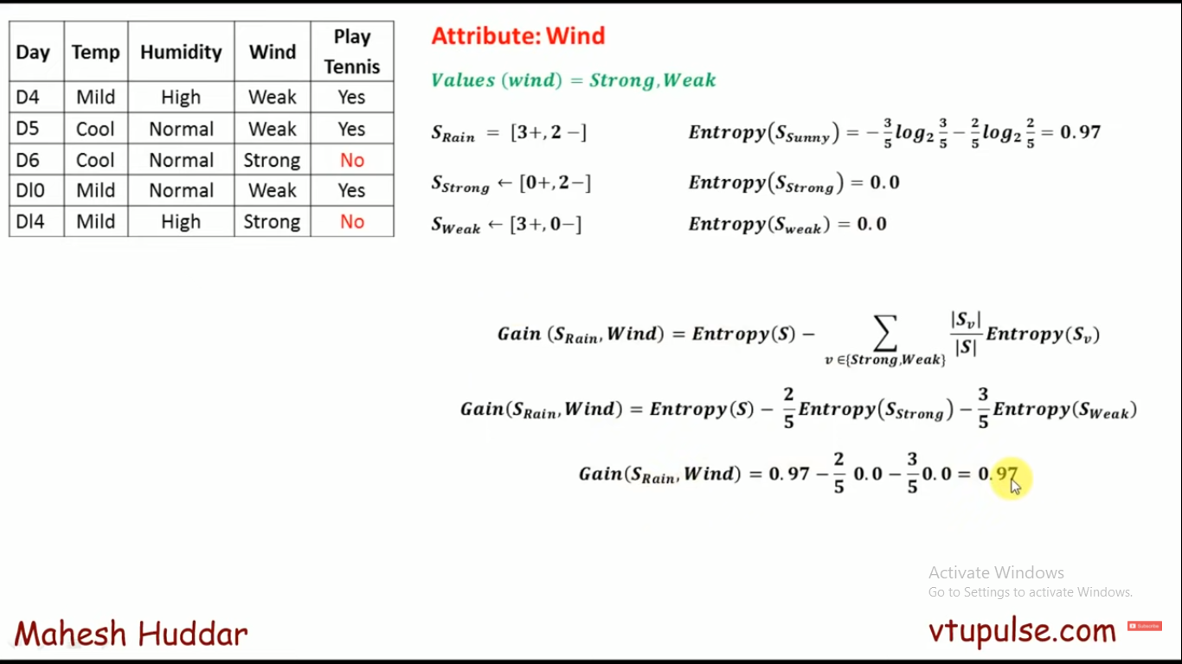

Slide 37
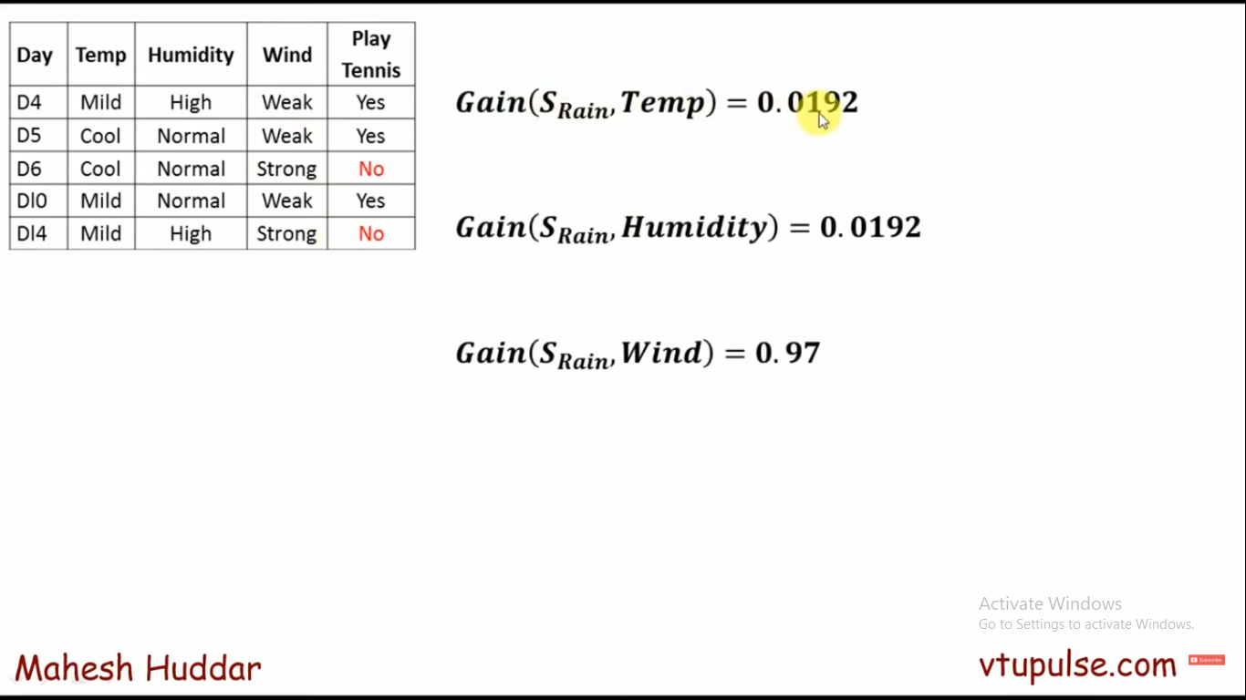

Slide 38
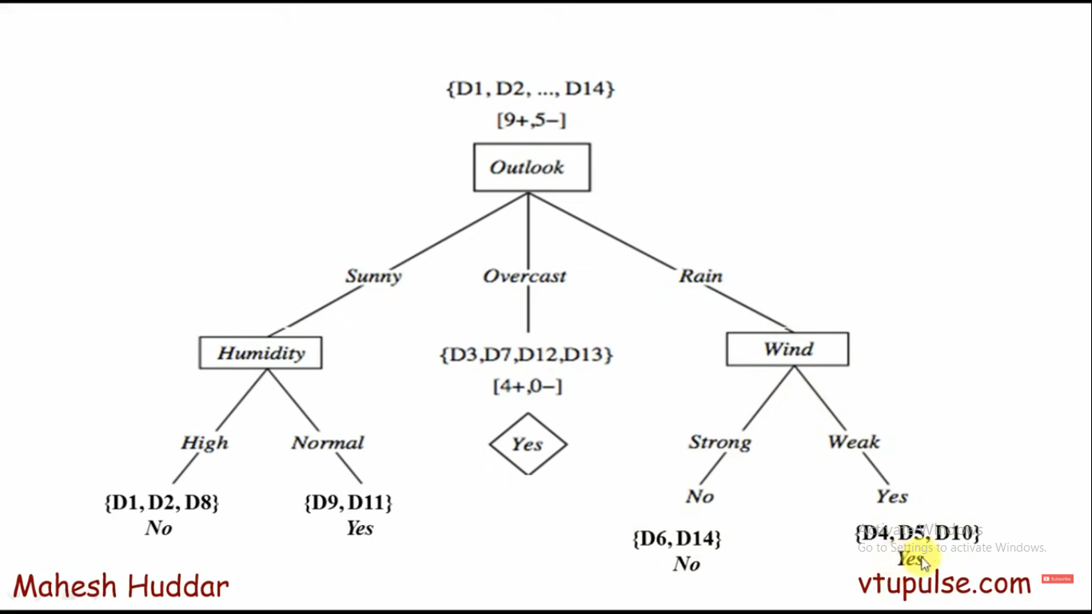
Final Tree

Slide 39
Recommended Video: https://www.youtube.com/watch?v=K9tani59cw4 https://www.youtube.com/watch?v=coOTEc-0OGw

Slide 40
Types of Decision Trees
Types of decision trees are based on the type of target variable we have. It can be of two types:
Categorical Variable Decision Tree: Decision Tree which has a categorical target variable then it called a Categorical variable decision tree.
Continuous Variable Decision Tree: Decision Tree has a continuous target variable then it is called Continuous Variable Decision Tree.

Slide 41
How to avoid/counter overfitting in Decision Trees?
Here are two ways to remove overfitting:
Pruning Decision Trees. In pruning, you trim off the branches of the tree, i.e., remove the decision nodes starting from the leaf node such that the overall accuracy is not disturbed.
Random Forest. Random Forest is an example of ensemble learning, in which we combine multiple machine learning algorithms to obtain better predictive performance.

Slide 42
Which is better Linear or tree-based models?
Depends on the kind of problem you are solving.
If the relationship between dependent & independent variables is well approximated by a linear model, linear regression will outperform the tree-based model.
If there is a high non-linearity & complex relationship between dependent & independent variables, a tree model will outperform a classical regression method.
If you need to build a model that is easy to explain to people, a decision tree model will always do better than a linear model. Decision tree models are even simpler to interpret than linear regression!

Slide 43
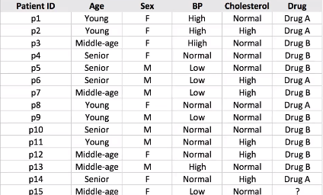
Homework!

Slide 44


